Slide 1


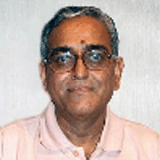
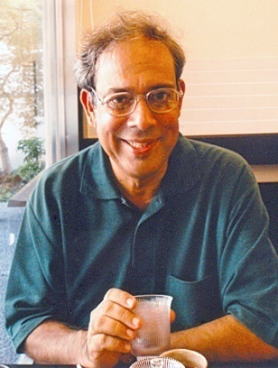
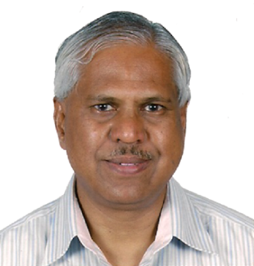
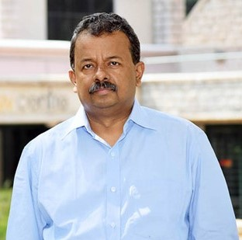
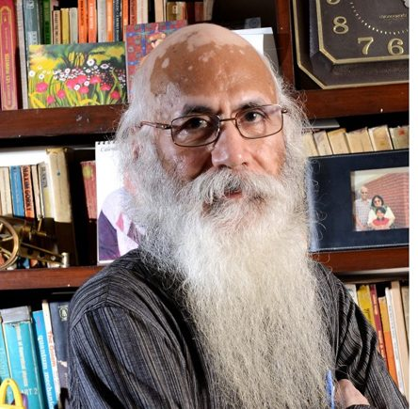
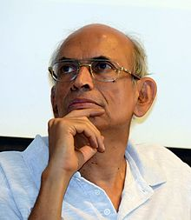
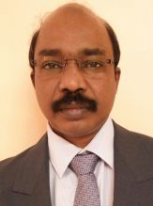
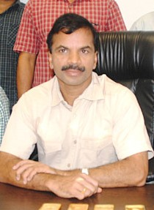
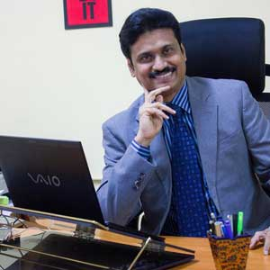
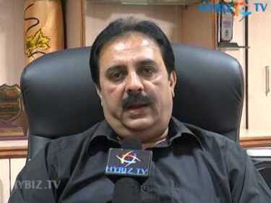
BITS GOA ECONOMICS CONCLAVE
20th- 21st March, 2017
Satya R. Chakravarty
Professor, Economics Research Unit, Indian Statistical Institute, Kolkata
Dr. M.G. Chandrakanth
Director, Institute for Social and Economic Change, Bangalore
Gopal Naik
Chairperson, Centre of Excellence for Urban Development, Economics & Social Sciences IIM, Bangalore
Arun Kumar
Retired Professor, Centre for Economic Studies and Planning School of Social Sciences, JNU, New Delhi
R. Nagaraj
Professor, Indira Gandhi Institute of Development Research, Mumbai
Madhav Gadgil
Professor, Centre for Ecological Sciences, Indian Institute of Science Bangalore
Dr. J. Dennis Rajakumar Director, EPW Research Foundation, Mumbai
K. Anpazhakan Commissioner of Central Excise & Service Tax, Goa
Dr. Sibichen K Mathew
IRS, Commissioner of Income Tax(TDS), Bengaluru
G. R. Akadas
Director , MSME-Development Institute, Hyderabad

